Slide 1
MongoDB vs. SQL
Introduction to MongoDB and SQL
Overview of their functionalities and use cases

Slide 2

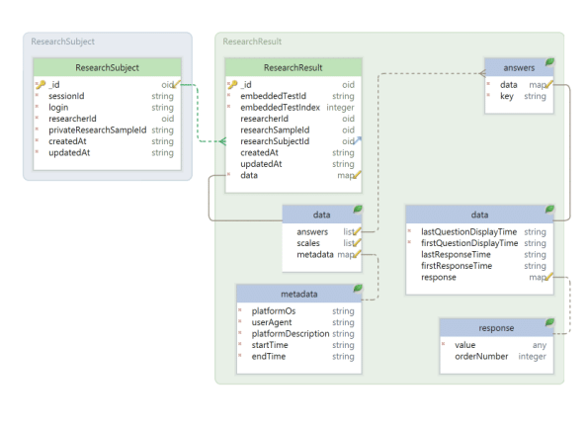
MongoDB
NoSQL database
Document-oriented
Flexible schema
JSON-like documents
Scalability and high-performance
Ideal for unstructured or semi-structured data

Slide 3
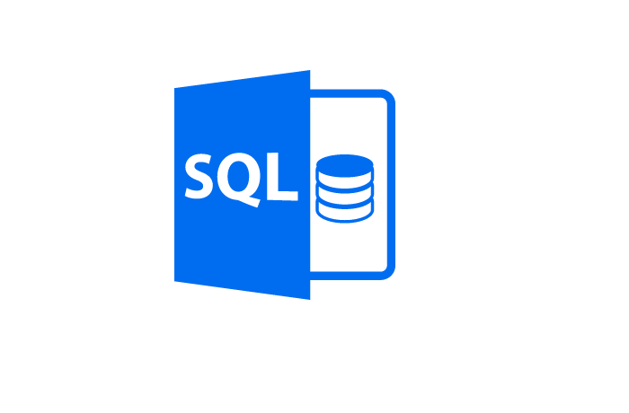
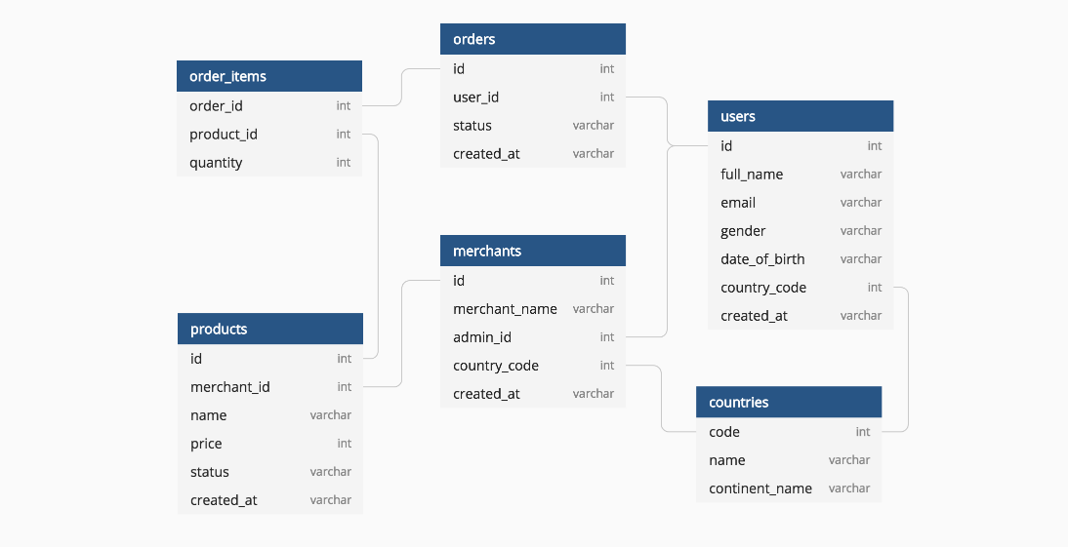
SQL
Relational database
Structured data with tables and rows
Fixed schema
SQL (Structured Query Language)
ACID-compliant transactions
Ideal for structured and complex data relationships

Slide 4

Comparison - MongoDB vs. SQL
Data Model:
MongoDB: Document-oriented model with flexible schema.
SQL: Relational model with fixed schema and defined relationships.
Scalability:
MongoDB: Horizontal scalability with sharding, suitable for large-scale distributed systems.
SQL: Vertical scalability with additional hardware resources, suitable for smaller to medium-sized systems.

Slide 5
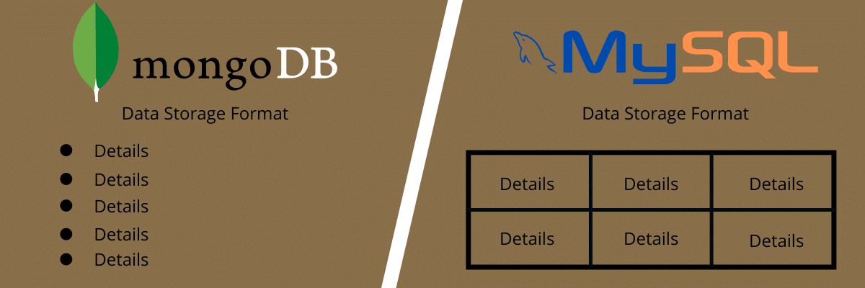
Comparison - MongoDB vs. SQL
Query Language:
MongoDB: Query documents using MongoDB Query Language (MQL) or MongoDB Compass.
SQL: Query tables using SQL (Structured Query Language).
Flexibility:
MongoDB: Dynamic schema allows easy modification of document structure.
SQL: Fixed schema ensures data consistency and integrity.

Slide 6
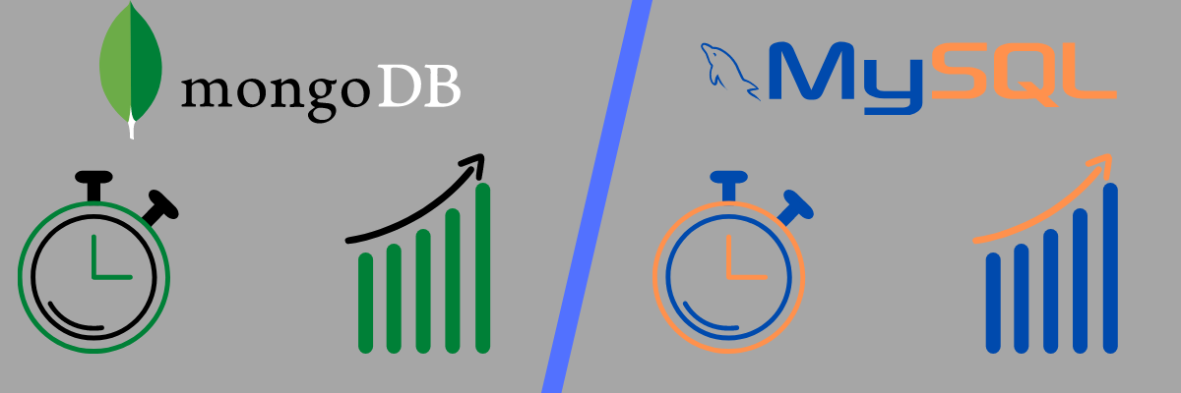
Comparison - MongoDB vs. SQL
Transactions and Joins:
MongoDB: Supports atomic operations within a single document but lacks full ACID-compliant transactions and joins.
SQL: Offers ACID-compliant transactions and supports complex joins between tables.

Slide 7
Conclusion
MongoDB and SQL have different strengths and use cases.
MongoDB excels in scalability and flexibility for unstructured data.
SQL provides strong data consistency, ACID compliance, and is suitable for complex relationships.
Find out more at the PowerPoint Getting Started Center
(Click the arrow when in Slide Show mode)
Notes:
In Slide Show mode, click the arrow to enter the PowerPoint Getting Started Center.

